Slide 1

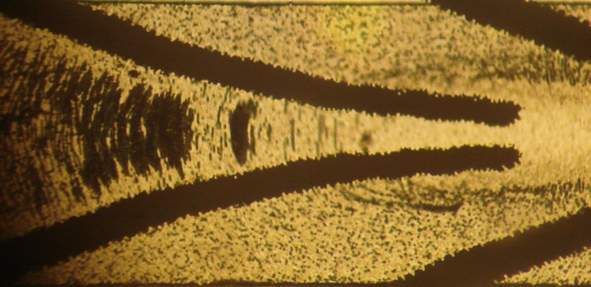
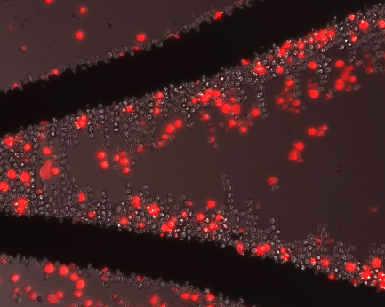
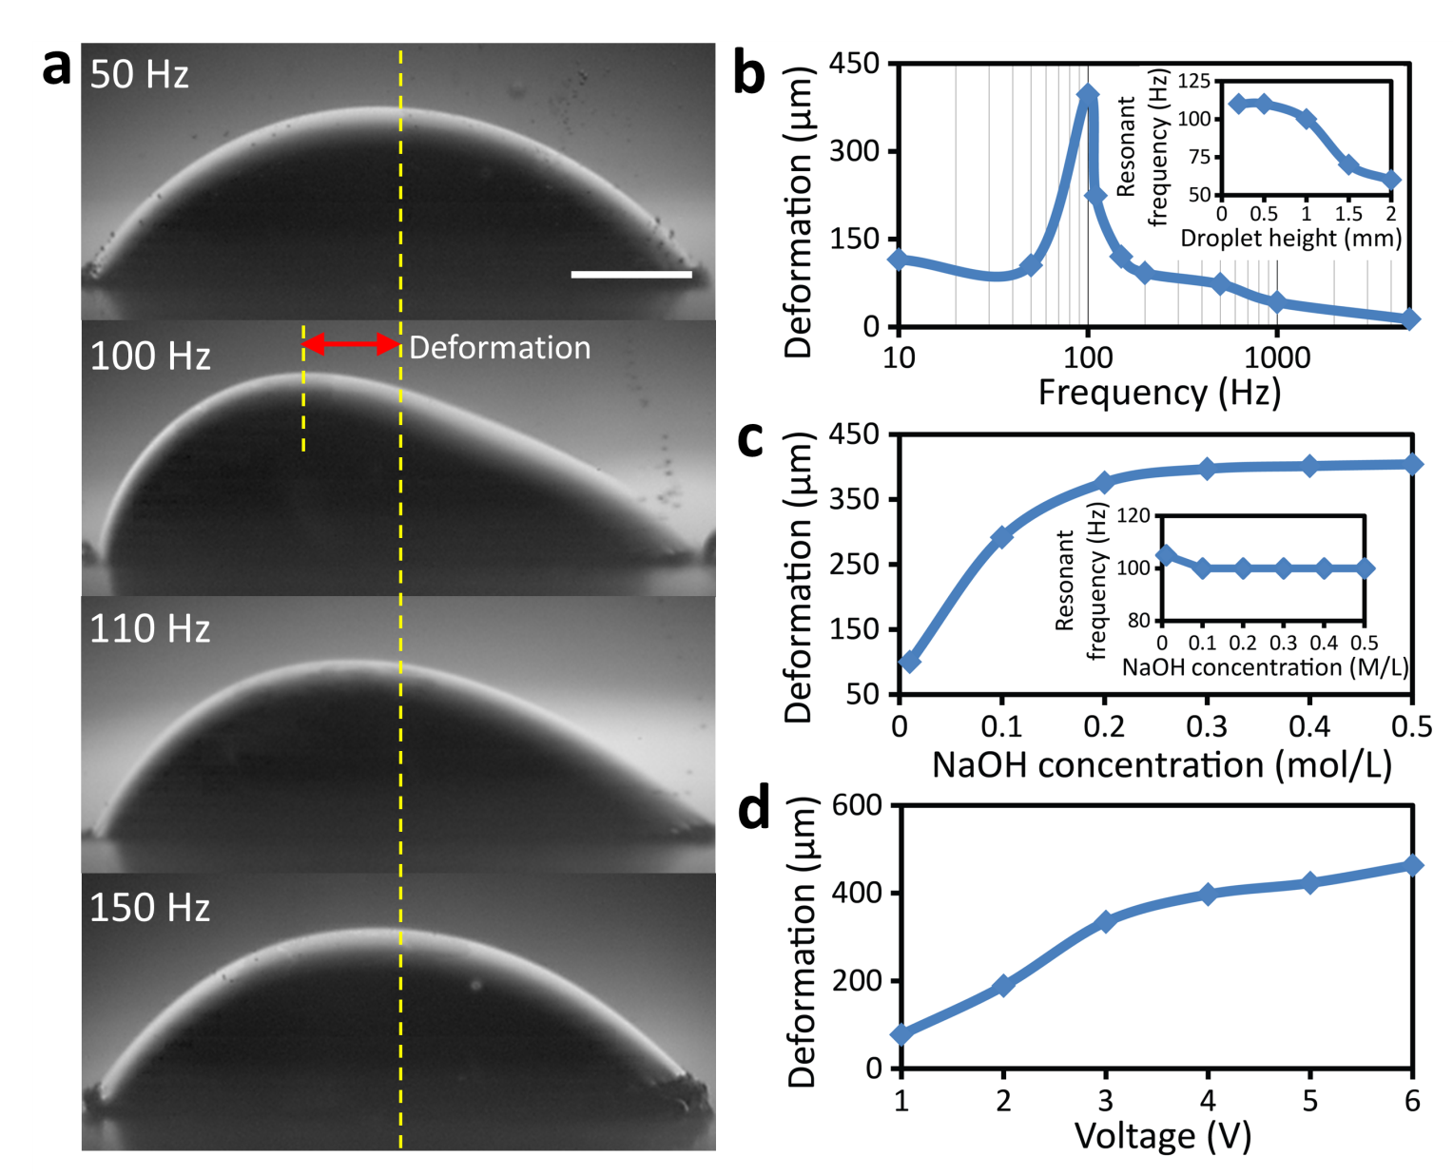
EEET2449 Research Methods for Engineers
Lecture 7: How to Read and Write a Paper
Francisco Tovar, PhD
francisco.tovarlopez@rmit.edu.au

Slide 2
A. Why do you need papers ?
PhD thesis
Papers
0: Abstract (1.5 pages)
1: Introduction (10 pages)
2: Literature survey (30-40 pages)
3: Theory or Materials & Methods (20-30 pages)
4: Results-a (25-35 pages)
5: Results-b (25-35 pages)
6: Results-c (25-35 pages)
7: Conclusions and Future research directions (10 pages)
Review paper
Thesis chapters
Result paper-1
Result paper-2
Result paper-3

Slide 3
B. Paper anatomy

Slide 4
B1. The structure of a paper
Title
Abstract
Keywords
Introduction
Materials & Methods
Theory
Principles of System
Results & Discussions
Supplementary
Conclusions + Future directions
References
Acknowledgement

Slide 5
B2. Title
Use a short title for your paper
On-chip manipulation of free droplets
Nature, 2003, 426, 6966, 515-516
Include keywords in the title
Controlled synthesis of non-spherical microparticles using microfluidics
Langmuir, 2005, 21, 6, 2113-2116
Make it exciting
Magnetic bead handling on-chip: new opportunities for analytical applications
Microfluidics & Nanofluidics, 2004, 1, 1, 22-40

Slide 6
B2. Title
Make sure you do not DIRECT the paper in the hands of wrong reviewers !
Microfluidic devices for the high-throughput chemical analysis of cells
Analytical Chemistry, 2003, 75, 21, 5646-5655
Human neural stem cell growth and differentiation in a gradient-generating microfluidic device
Lab on a Chip, 2005, 5, 4, 401-406
The reviewer is likely to be an engineer!
The reviewer is likely to be a biologist !

Slide 7
B3. Abstract
Significance:
Highlight the significance of your work
20-30 words
Limitations of current techniques:
What is wrong with other works?
30-50 words
What you have done:
Introduce your work
20-30 words
Should have a converging-diverging structure
A bit result:
40-60 words
200 words
So what?
20-30 words

Slide 8
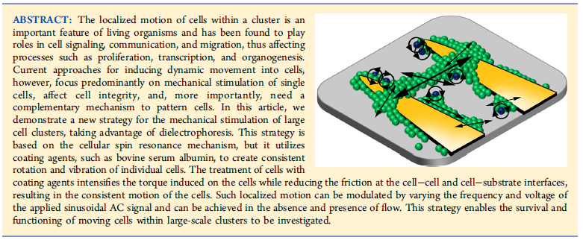
B3. Abstract−Example 1:
Controlled Rotation and Vibration of Patterned Cell Clusters Using Dielectrophoresis
Analytical Chemistry, 2015, 87, 2389–2395

Slide 9
B3. Abstract−Example 1:
The localized motion of cells within a cluster is an important feature of living organisms and has been found to play roles in cell signaling, communication, and migration, thus affecting processes such as proliferation, transcription, and organogenesis.
Current approaches for inducing dynamic movement into cells, however, focus predominantly on mechanical stimulation of single cells, affect cell integrity, and, more importantly, need a complementary mechanism to pattern cells.
In this article, we demonstrate a new strategy for the mechanical stimulation of large cell clusters, taking advantage of dielectrophoresis.
This strategy is based on the cellular spin resonance mechanism, but it utilizes coating agents, such as bovine serum albumin, to create consistent rotation and vibration of individual cells. The treatment of cells with coating agents intensifies the torque induced on the cells while reducing the friction at the cell−cell and cell−substrate interfaces, resulting in the consistent motion of the cells. Such localized motion can be modulated by varying the frequency and voltage of the applied sinusoidal AC signal and can be achieved in the absence and presence of flow.
This strategy enables the survival and functioning of moving cells within large-scale clusters to be investigated.
Significance:
Limitations of current techniques:
What you have done:
A bit result:
So what?

Slide 10
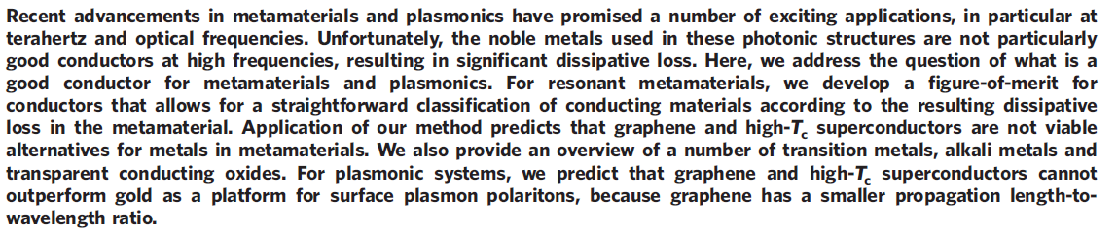
B3. Abstract−Example 2:
A comparison of graphene, superconductors and metals as conductors for metamaterials and plasmonics
Nature Photonics, 2012, 6, 259–264

Slide 11
B3. Abstract−Example 2:
Recent advancements in metamaterials and plasmonics have promised a number of exciting applications, in particular at terahertz and optical frequencies.
Unfortunately, the noble metals used in these photonic structures are not particularly good conductors at high frequencies, resulting in significant dissipative loss.
Here, we address the question of what is a good conductor for metamaterials and plasmonics.
For resonant metamaterials, we develop a figure-of-merit for conductors that allows for a straightforward classification of conducting materials according to the resulting dissipative loss in the metamaterial. Application of our method predicts that graphene and high-Tc superconductors are not viable alternatives for metals in metamaterials. We also provide an overview of a number of transition metals, alkali metals and transparent conducting oxides.
For plasmonic systems, we predict that graphene and high-Tc superconductors cannot outperform gold as a platform for surface plasmon polaritons, because graphene has a smaller propagation length-to wavelength ratio.
Significance:
Limitations of current techniques:
What you have done:
A bit result:
So what?

Slide 12
B3. Abstract
Significance:
Highlight the significance of your work
20-30 words
Limitations of current techniques:
Introduce your approach
30-50 words
Should have a converging-diverging structure
What you have done:
Introduce your work
20-30 words
Make it exciting
A bit result:
40-60 words
Rewrite it at least 5 times !
Ask your friends to review it for you
200 words
So what?
20-30 words

Slide 13
B4. Keywords
The keywords might determine the reviewer of your paper
Be careful about the weight function of your keywords
Microfluidics, Dielectrophoresis, Cell sorting
Cancer cells, Cell sorting, Dielectrophoresis
The reviewer is likely to be an engineer !
The reviewer is likely to be a biologist !
Use a few general keywords to get citations

Slide 14
B5. Introduction
Significance:
Highlight the significance of your work
100-150 words
Literature review:
Categorise the existing works
400-500 words
Should have a triangular structure
Your work:
Advertise your discoveries
150-200 words
800 words

Slide 15
B5. Introduction
Significance:
Highlight the significance of your work
100-150 words
It should be general, easy to understand for other researchers
Use references from Nature, Science, ….
Use statistical data from reliable sources
800 words

Slide 16
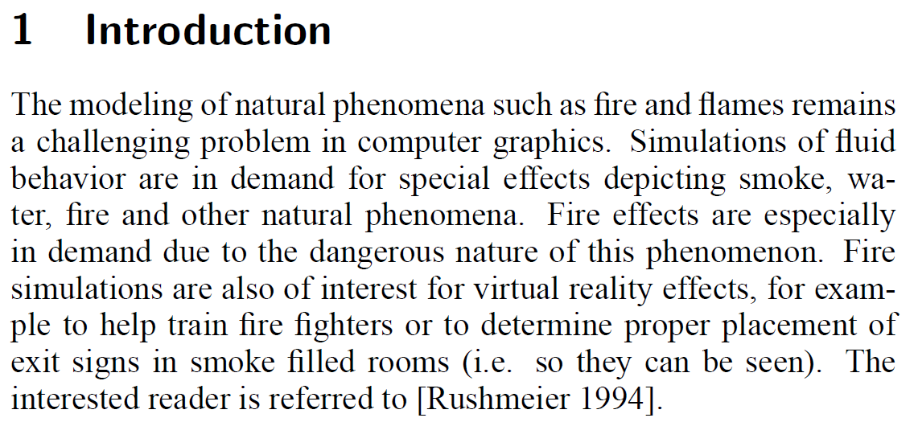
B5. Introduction−Example 1:
Significance:
Highlight the significance of your work
100-150 words
Physically based modeling and animation of fire ACM Transactions on Graphics (TOG) 21 (3), 721-728

Slide 17
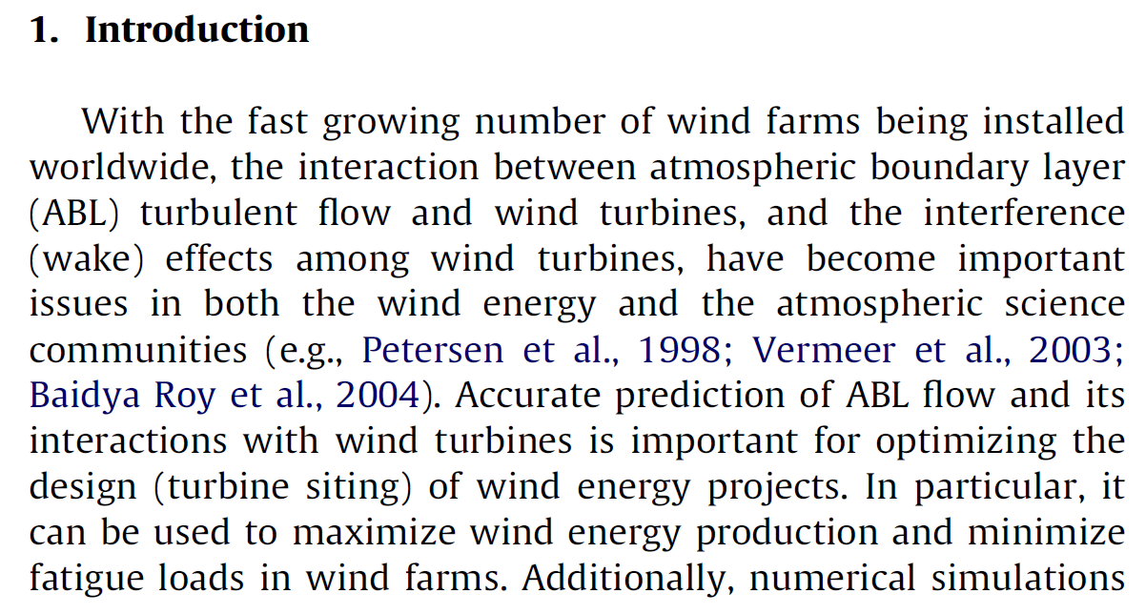
B5. Introduction−Example 2:
Significance:
Highlight the significance of your work
100-150 words
Large-eddy simulation of atmospheric boundary layer flow through wind turbines and wind farms
J. Wind Eng. Ind. Aerodyn. 99 (2011) 154–168

Slide 18
B5. Introduction
You should build a story here !
Literature review:
Categorise the existing works
400-500 words
Categorise the references and discuss about their advantages/disadvantages
But highlight their disadvantages !
You should use the word ‘however’
800 words

Slide 19
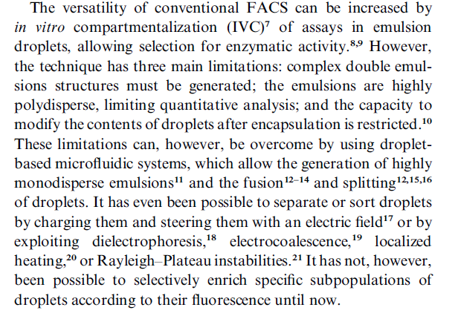
B5. Introduction−Example 3:
Literature review:
Categorise the existing works
400-500 words
Fluorescence-activated droplet sorting (FADS): efficient microfluidic cell sorting based on enzymatic activity
Lab on a Chip, 2009, 9, 1850–1858

Slide 20
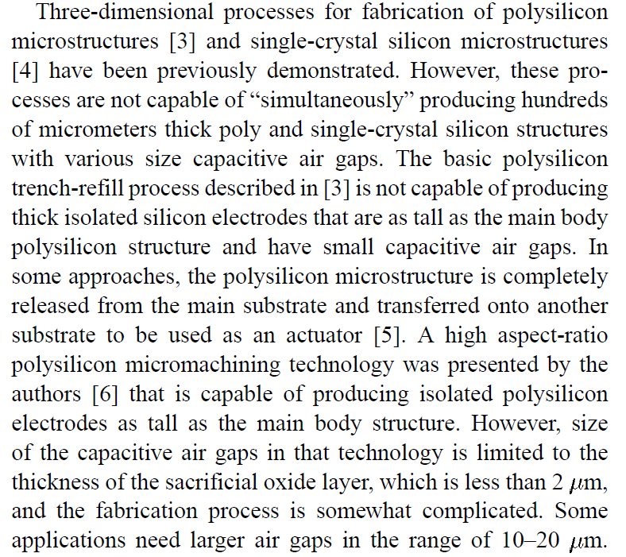
B5. Introduction−Example 4:
Literature review:
Categorise the existing works
400-500 words
High Aspect-Ratio Combined Poly and Single-Crystal Silicon (HARPSS) MEMS Technology
Journal of Microelectromechanical Systems, 2000, 9, 288-294

Slide 21
B5. Introduction
About the references:
Assuming that you are going to cite 12-15 papers in this section:
80% of the references should have been published within the last 5 years
Literature review:
Categorise the existing works
400-500 words
3-5 references should be from the recognised groups
2-3 references should be from your destination journal
Do not cite the papers from very low impact factor journals
800 words
Cite the papers, which have cited the works from your group !

Slide 22
B5. Introduction
This is basically the most important part of your paper
The reviewers and later the people generally read it first
Starts with:
In this work, we present …..
Here, we present ……
Your work:
Advertise your discoveries
150-200 words
Should be like the trailer of a movie
Rewrite it 3-5 times
800 words
I call this section ‘Strategic point # 1’

Slide 23
B5. Introduction−Example 5:
Your work:
Advertise your discoveries
150-200 words
In this paper, we demonstrate a new dielectrophoresis-based approach for stable immobilisation and analysis of cells under biologically relevant conditions. This approach minimises the adverse effects of strong electric fields on the viability and functioning of cells, by activating the field for a short duration of 120 s, just long enough to immobilise the cells. More importantly, this approach is not limited by low electrical conductivity (LEC) isotonic buffers commonly used in dielectrophoresis experiments; as once the field is deactivated, high conductivity biological buffers such as HEPES can be flushed through the microfluidic system.
Analysing calcium signalling of cells under high shear flows using discontinuous dielectrophoresis
Scientific Reports, 2015, 5, 5:11973, DOI: 10.1038/srep11973

Slide 24
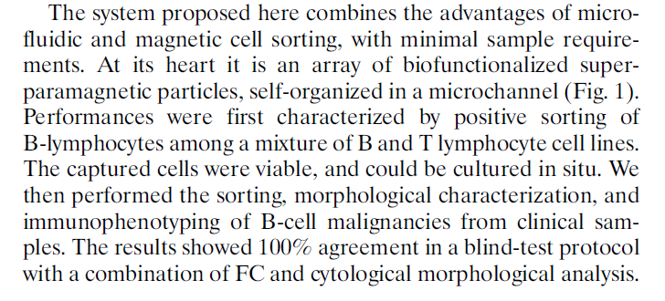
B5. Introduction−Example 6:
Your work:
Advertise your discoveries
150-200 words
Microfluidic sorting and multimodal typing of cancer cells in self-assembled magnetic arrays
PNAS, 2010, 107, 33, 14524–14529

Slide 25
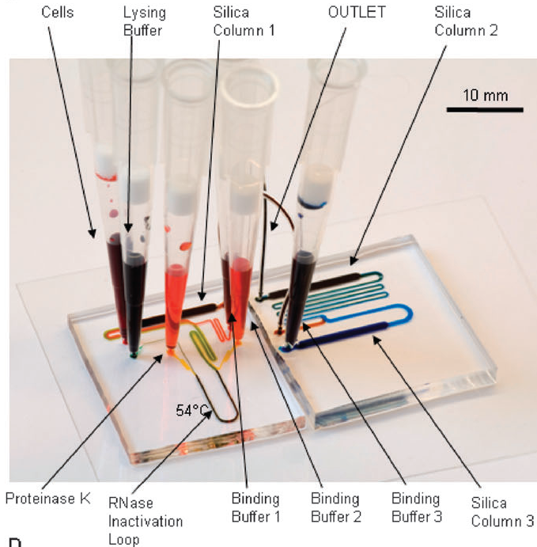
B6. Materials & Methods
Write it in such a way that you can do the same experiments in the next five years
Take artistic photos from your experimental setup
Genome-wide transcriptome analysis of 150 cell samples
Integrative Biology, 2009, 1, 99–107

Slide 26
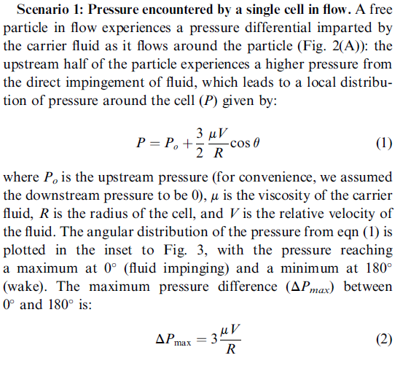
B7. Theory
Do not present the Theory in a boring way !
Assume that you have developed the Theory by yourself
Describe it as a story
Deformability considerations in filtration of biological cells
Lab on a Chip, 2010, 10, 837–842

Slide 27
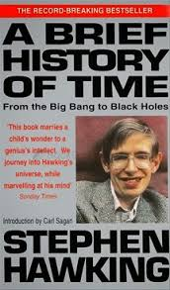
B7. Theory
Try to describe the most complicated things in a simple way !

Slide 28
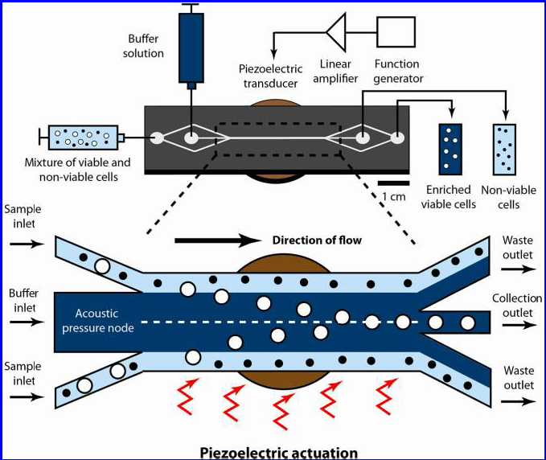
B8. Principles of System
Take advantage of Schematic figures
Use PowerPoint or Google Sketchup software
If possible, combine Theory and Principles of System !
Acoustophoretic Sorting of Viable Mammalian Cells in a Microfluidic Device
Analytical Chemistry, 2012, 84, 10756−10762

Slide 29
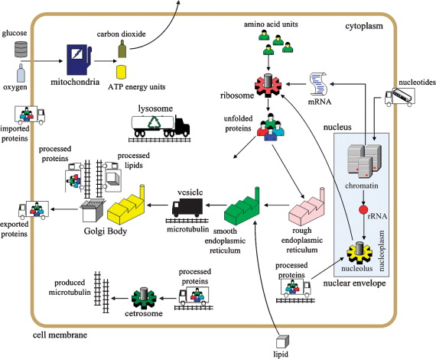
B8. Principles of System
At a glance: Cellular biology for engineers
Computational Biology and Chemistry, 2008, 32, 315–33

Slide 30
B8. Principles of System
I call this section ‘Strategic point # 2’
Introduction-last paragraph
Strategic point # 1
Strategic point # 2
Principles of System

Slide 31
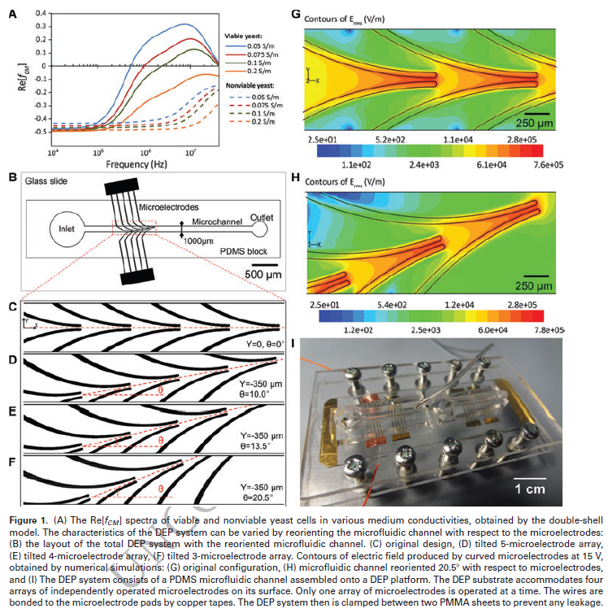
B9. Results & Discussions−Example 1:
Should have 3-4 Mega figures
The figures + captions should be self-descriptive
Consider each figure as an art work !
Reorientation of microfluidic channel enables versatile dielectrophoretic platforms for cell manipulations
Electrophoresis, 2013, 34, 1407-1414

Slide 32
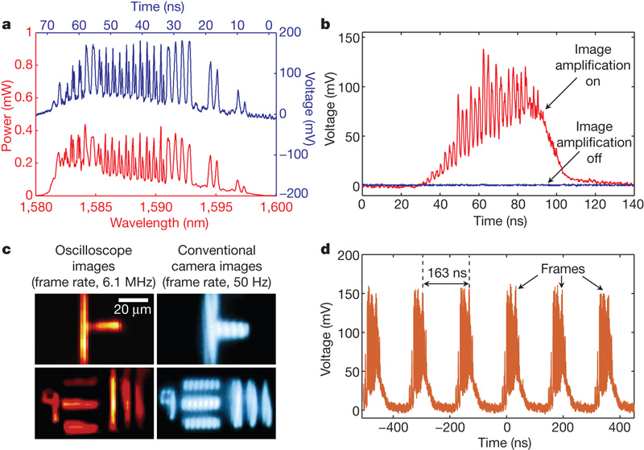
B9. Results & Discussions−Example 2:
Serial time-encoded amplified imaging for real-time observation of fast dynamic phenomena
Nature, 2009, 458, 1145-1149
a, Comparison between the temporal waveform (single pulse) captured by the oscilloscope (blue) and the spectrum measured by a conventional optical spectrum analyser (red). The consistency between them validates the frequency-to-time mapping operation performed by the dispersive Fourier transformation. b, The temporal waveform, representing the image, with (red) and without (blue) the image amplification. The optical amplification raises the otherwise undetectably weak signal significantly above the detector noise floor, overcoming the fundamental compromise between imaging sensitivity and frame rate. c, Images of a calibration target captured by the STEAM camera, compared with images obtained using a conventional infrared camera. The shutter speed is estimated to be 440 ps. The granularity in the horizontal direction is an artefact of the particular implementation of the 2D spatial disperser, and is not a fundamental characteristic of the system. d, The pulse train captured by the single-pixel photodiode and displayed on the real-time digitizer (oscilloscope). The gap between consecutive pulses is 163 ns. Each pulse contains one frame of the 2D image

Slide 33
B9. Results & Discussions
I call the Figures + Captions ‘Strategic point # 3’
Introduction-last paragraph
Strategic point # 1
Strategic point # 2
Principles of System
Strategic point # 3
Figures + Captions

Slide 34
B9. Results & Discussions
Figure 1
Conclude each figure
Make connections
Write it as a continuous story
Figure 2
Conclude each figure
Make connections
Figure 3

Slide 35
B10. Supplementary
Do not deprive yourself of supplementary !
Your paper should be the tip of the ice
Put boring stuff in the supplementary !

Slide 36
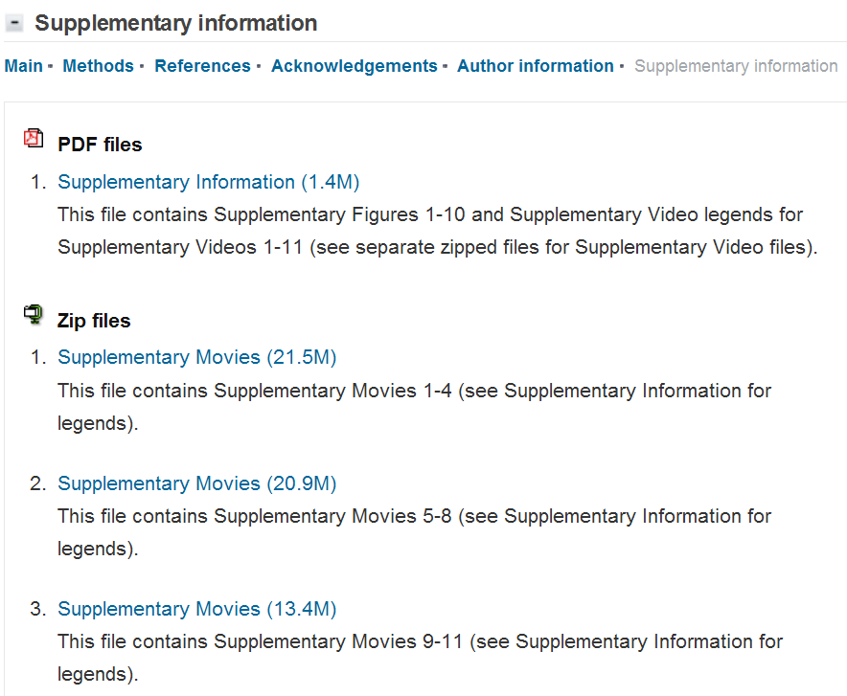
B10. Supplementary−Example 1:
HIV-infected T cells are migratory vehicles for viral dissemination
Nature, 2012, 490, 283–287

Slide 37
B11. Conclusions + Future directions
Should have a triangular structure
Take advantage of bullets or numbers to summarise your work
Be a dreamer when talking about the future directions
Your work:
Summarise your findings
125-150 words
It should be interesting for other researchers
It should explain how the people from other fields can be benefited from your work
Future work:
What can be done by others ?
50-75 words
200 words

Slide 38
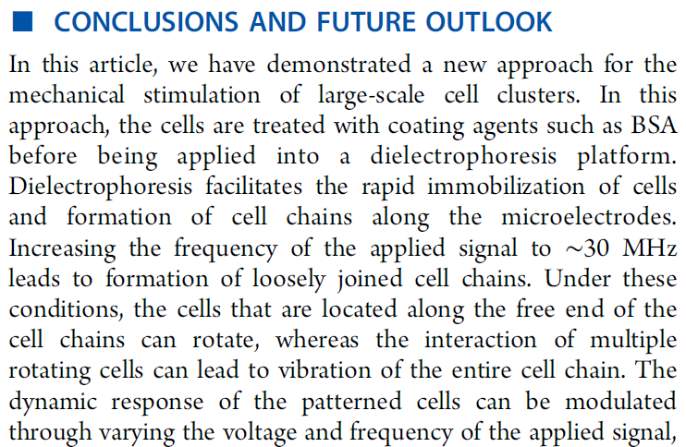
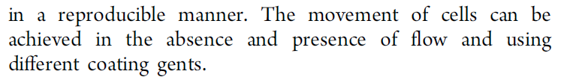
B11. Conclusions + Future directions −Example 1:
Controlled Rotation and Vibration of Patterned Cell Clusters Using Dielectrophoresis
Analytical Chemistry, 2015, 87, 2389–2395

Slide 39
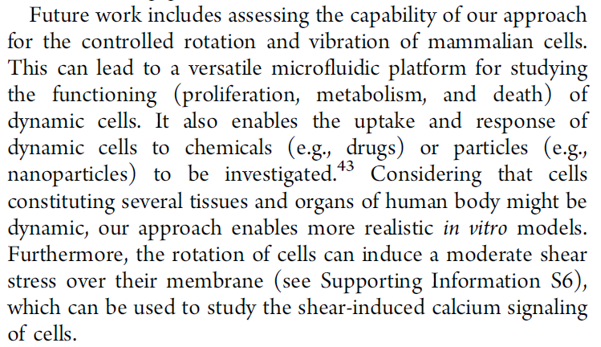
B11. Conclusions + Future directions −Example 1:
Controlled Rotation and Vibration of Patterned Cell Clusters Using Dielectrophoresis
Analytical Chemistry, 2015, 87, 2389–2395

Slide 40
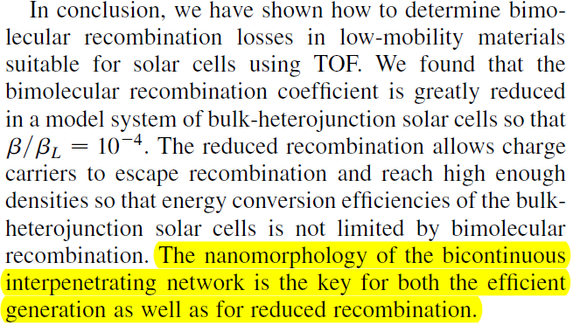
B11. Conclusions + Future directions −Example 2:
Bimolecular Recombination Coefficient as a Sensitive Testing Parameter for Low-Mobility Solar-Cell Materials
Physical Review Letters, 2005, 94, 176806

Slide 41
B12. References
Take advantage of EndNote or similar data bases
Categorise references for yourself
B13. Acknowledgement
Acknowledge the people who have had contributions to your work
Acknowledge the RMIT’s facilities you have used
Acknowledge any supports via ARC, NHMRC, …..

Slide 42
B14. Final anatomy of the paper
Literature
Introduction
Results
Your paper should look like a converging-diverging nozzle !
Conclusions
Future directions
Literature

Slide 43
Thank you !

